Slide 1
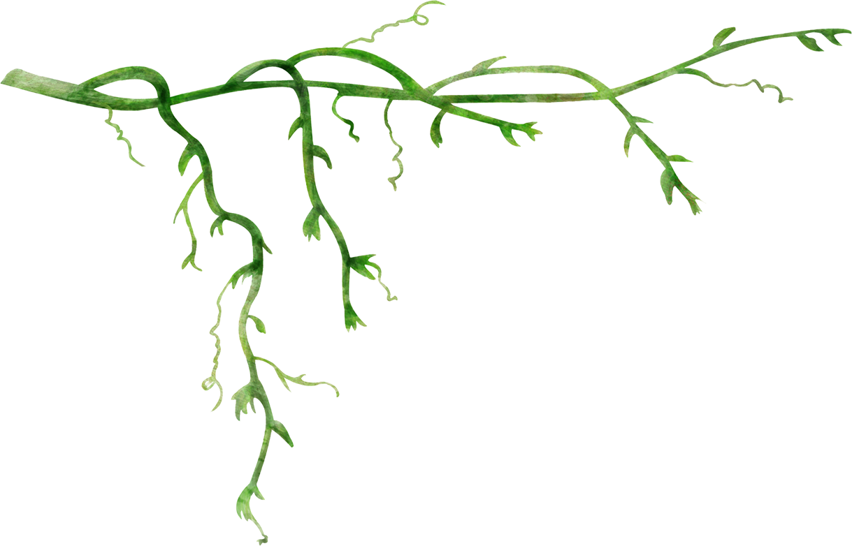
Sycamore Transfer
Lauren Hampson, Zane Durante, Andrew Charters, Ishan Shah, Kousheyo Kundu, Tomas Acin-Chediex
CSCI 201 Final Project

Slide 2
What is Style Transfer?

Slide 3
What did we use?

Slide 4
Project Dynamic

Slide 5
Create Account
Sign In
Global Feed
Personal Feed
Profile
Home
Output Page

